Slide 1
By Unus
MedItatIon and INITIaTIOn
Feast of Tabernacles 2015

Slide 2
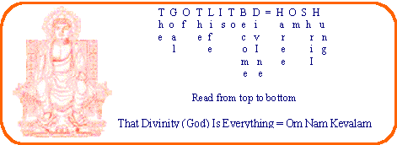
What is the Goal of the Life?
Haree Om Shrii Hung The Goal Of Life Is To Be(come) Divine
Om Nam Kevalam That Divinity (God) is Everything
Notes:
.

Slide 3
How do we reach the goal?
www.maitreya.org
Notes:
.

Slide 4
What is the First Step?
Awakening of the Spiritual Forces
Notes:
To give an idea about our experience in major projects.

Slide 5
What is Meditation?
The process of directing attention from going outward to going inward.
It is a process of struggling to know:
The Self
The relationship of the Self with the Universe
Overcoming those forces which are in our way toward the goal to be(come) Divine.
God and self-realization are not for those who want to escape the struggling but are for those who are soldiers of the Lord.

Slide 6
How do we Meditate/Struggle?
To meditate on the HOSH mantra, sit somewhere you feel comfortable, keeping your spine and neck straight. When you feel relaxed, slowly start to repeat the mantra within yourself.
Become familiar with its vibration and try to let all other thoughts gently pass away!

Slide 7
How do we Meditate/Struggle?
Connect your breath with the repetition of the mantra. Breathe in "Haree Om Shrii Hung" and think: The Goal of the Life is to Be(come) Divine. Breathe out "Om Nam Kevalam" and think: That Divinity (God) is Everything.
There is a pause between breathing in and breathing out. There is also a pause between breathing out and breathing in. Realize these pauses, the Stillness in them.
These pauses are the Infinite Now, realize their vibration (Silence) between each breath...

Slide 8
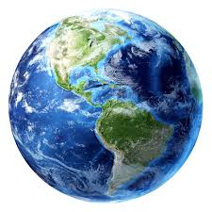
Meditation Process
…your consciousness (Self) is expanding outward!
…filled the whole earth, gently leave your body and visualize that you are sitting on the top most part of the earth!
… go to the center of the universe…

Slide 9
Initiation and Meditating on the Word
Warning!
To meditate on the Word, you should have a Covenant with God, Maitreya and the Mission of Maitreya!
Those who would not strive to follow the Eternal Divine Path, Covenant with the Mission and Maitreya and are not, eventually, 100% dedicated, supporters and One with the Mission, might go insane, or Thrown to the outer Darkness!

Slide 10
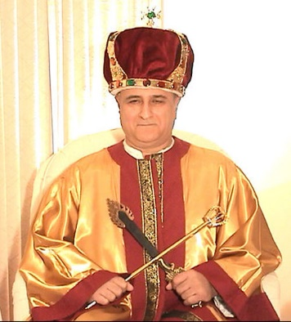
The Word (The Holy Name)
There are six parts in the Word (the Holy Name) Meditation/Initiation:
Introduction
First Part (Love)
Second Part (Powers)
Third Part (Knowledge)
Fourth Part (Light)
Highest Realization and/or state (Oneness with Light/God)
“No One Goes to the Father but through Me!”

Slide 11
Calling Elects
“There is a responsibility that comes with receiving The Word and using it. That responsibility is that you hear these words, you understand the Revelation, and you dedicate your life to the Eternal Divine Path, follow the Eternal Divine Path, purify yourself, and work toward the creation of the Communities of Light and the Kingdom. That is the Will of God.”
Maitreya, Calling Elects 04/22/2006

Slide 12
All Thanks To God!
Sal-Om!

